Slide 1

FPGesture Controlled Video Enhancement
6.111 Final Project
Soojung Bae, Jorge Tomaylla Eme
Notes:
Good afternoon everyone.. And we are here to present the most recent updates on our project, FPGesture Controlled Video Enhancement.

Slide 2
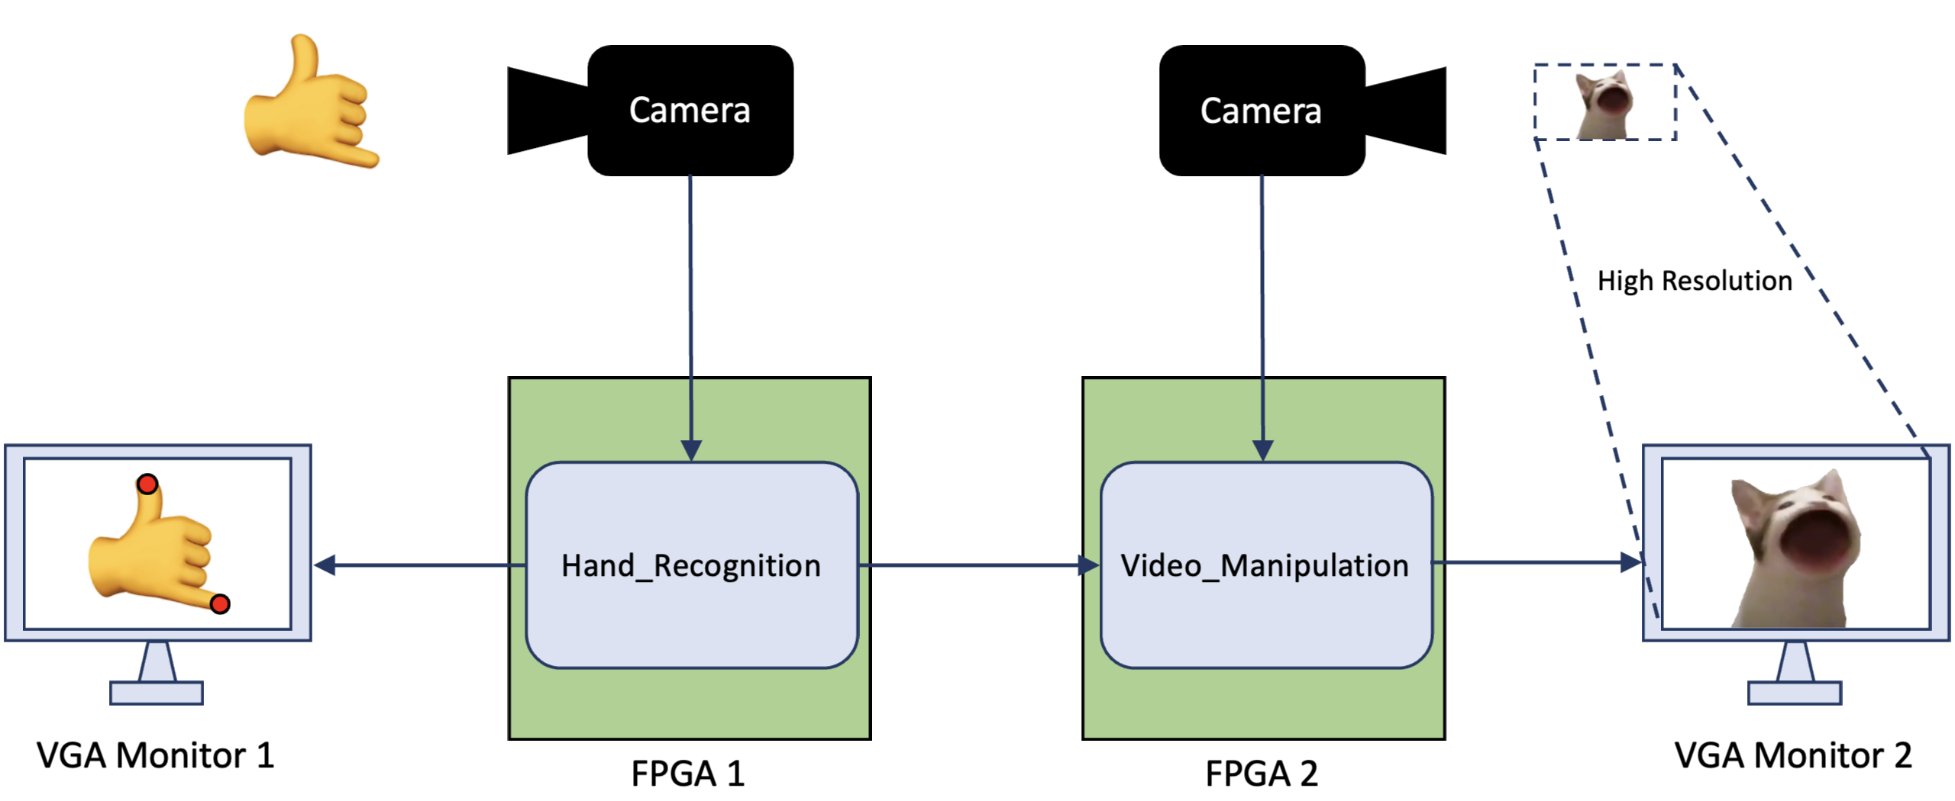
Project Design (from 5,000 ft up)
pmodb
Q) Why use two cameras, two boards?
Notes:
As a reminder, this is the very high level design. The project is divided into 2 main components: 1. Hand gesture recognition, which aims to encode hand movement like this (point up) and this (zoom out) by solving the blob detection problem, and 2. Video Manipulation and enhancement through the bicubic upscaling algorithm. Why use 2 cameras and 2 boards?, you might ask. Well, we need one camera keeping track of hand movement while the other camera is the input and object of video enhancement. Although we could certainly combine the modules in 1 FPGA, we like the idea of having independent modules and resources like BRAM, as well as camera independence. So let’s get to it..

Slide 3
Video Manipulation

Slide 4
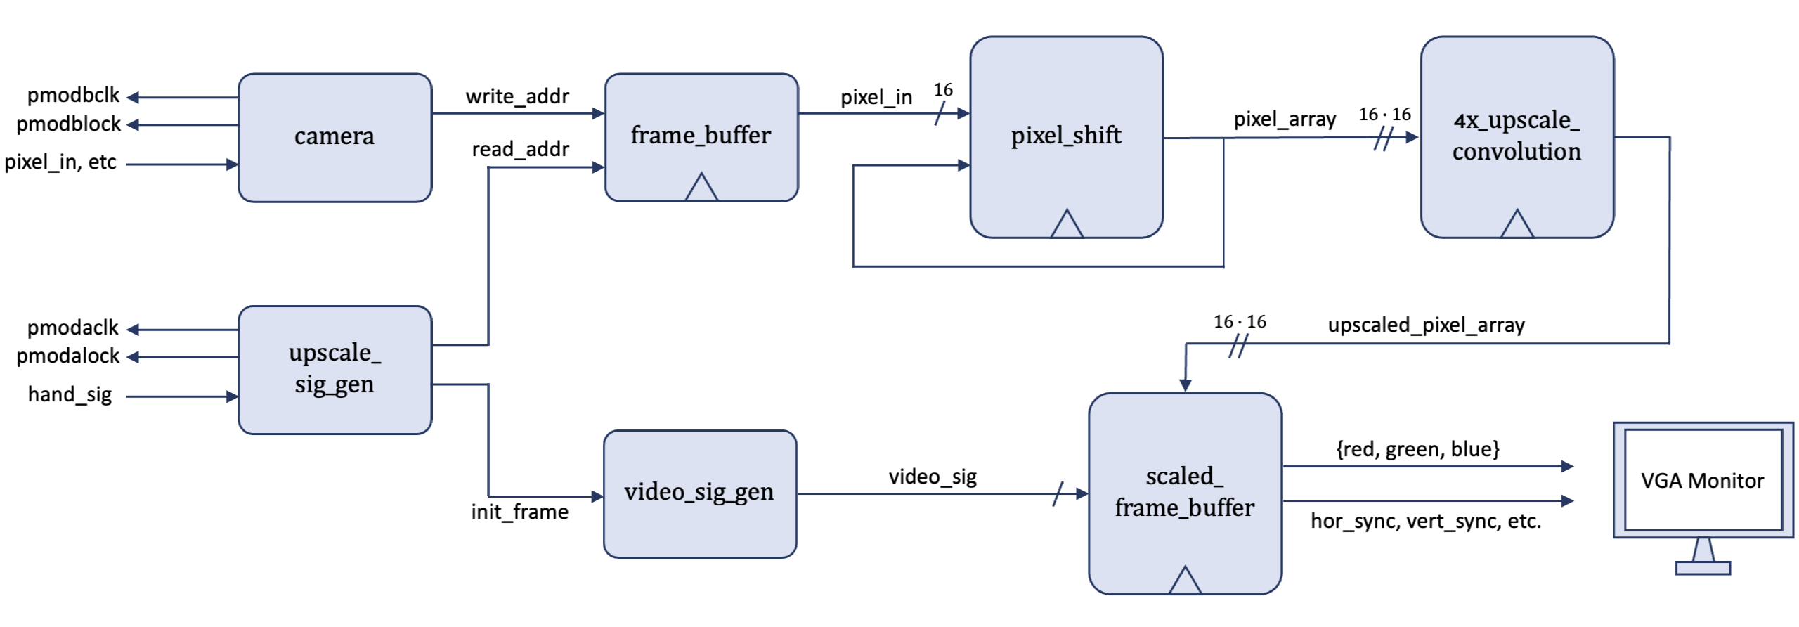
Block Diagram: Video Manipulation
Video Upscaling
Lab 05/06

Slide 5
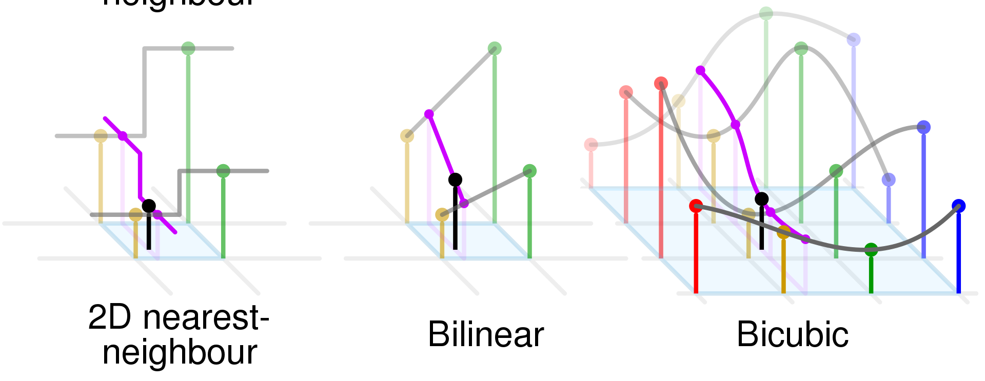
Upscaling Algorithms
Precision (Smooth)
vs.
Slow & Costly
Artifacts
FPGA!
Reference) Comparison of nearest-neighbour, bilinear and bicubic interpolation methods by CMG Lee [1]

Slide 6
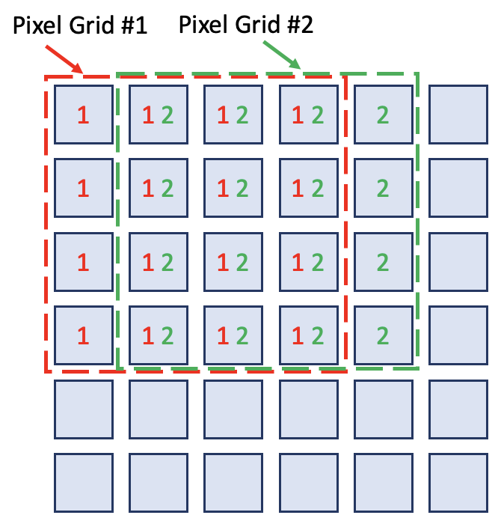
4x Upscaling: Pixel Shift
Upscaling is convolution of 4-by-4 continuous image patches
→ Pixel-level pipelining maximizes throughput

Slide 7
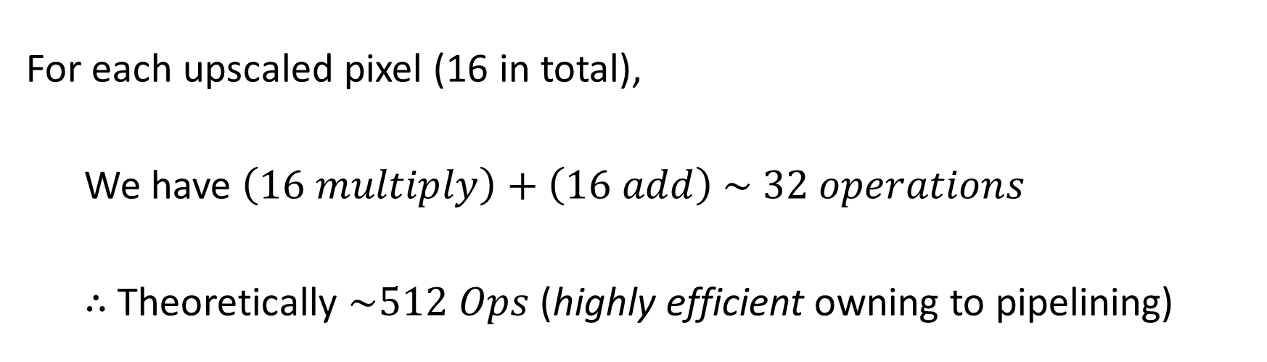

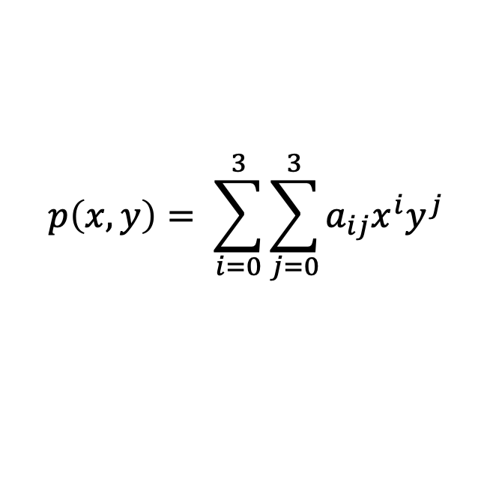
4x Convolution Module (Bicubic Interpolation)
$$p\left(x,y\right)= \sum_{i=0}^{3}{\sum_{j=0}^{3}{a_{ij}x^{i}y^{j}}}$$
$${( a}_{ij}=f\left(p_{00}, p_{01}, …, p_{44}\right))$$
For each upscaled pixel (16 in total),
We have $\left(16 multiply\right)+\left(16 add\right) \sim 32 operations$
$∴$ Theoretically $\sim 512 Ops$ (highly efficient owning to pipelining)
Notes:
- Pixel = {5’b, 6’b, 5’b}

Slide 8

Frame Buffer (for scaled pixels)
BRAM 1
Pixel Row #1
BRAM 2
Pixel Row #2
MUX
BRAM 3
Pixel Row #3
BRAM 4
Pixel Row #4
$$h_{count} [2:0]$$

Slide 9
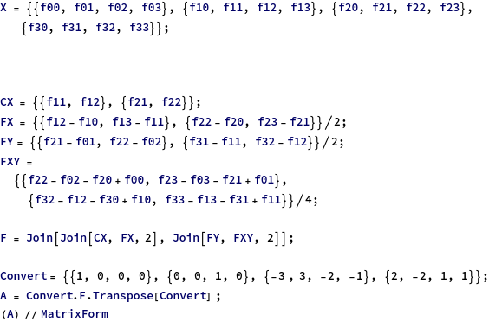
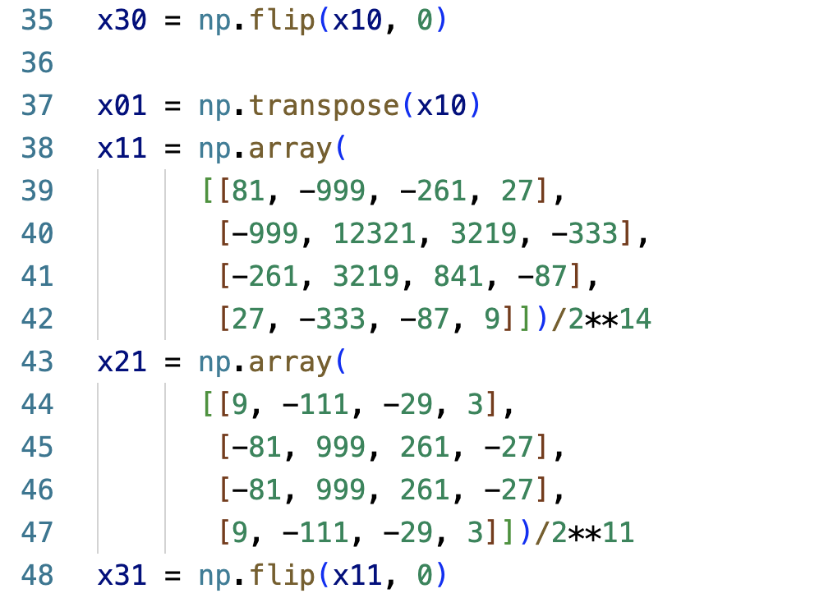
Python Demo
Hard-coded filter vs. CV2 Python package methods
Mathematica to acquire filter coefficients
Python follows the exact FPGA algorithm

Slide 10
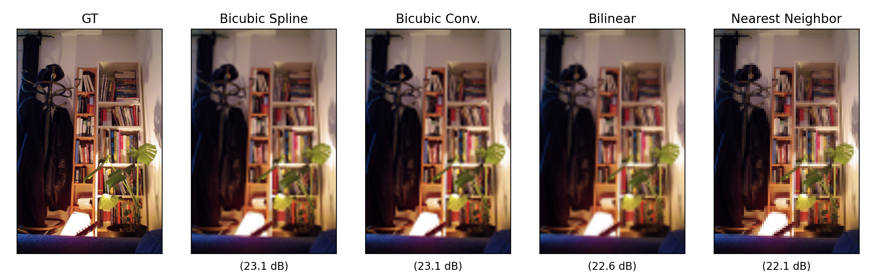
Python Demo
Hard-coded filter vs. CV2 Python package methods
(23.1 dB)
(Ours)
(23.1 dB)
(22.6 dB)
(22.1 dB)
Notes:
23.1 23.1 22.6 22.1

Slide 11
Design Evaluation: Video Manipulation
Speed | Performance | Resource Utilization
Latency
Accuracy
Memory
Throughput
Bit Arithmetic (errors)
Filter’s performance
Arithmetic Units
Limited by HDMI (60 fps)
Compare w/ Software Implementations
How effective is our pipelining strategy?
Notes:
1) Latency / Throughput
HDMI frame speed (30 fps=0.03 sec/frame) x (Image Size)
2) Accuracy
Depending on the choice of Bit arithmetic
3) Resource Utilization
Pixel-level pipelining → reduced memory and LUT utilization

Slide 12
Project Overview – Video Manipulation
(Commitment) With pixel-level pipelining, Highly optimized bicubic upscaling algorithm of video stream implemented purely on FPGA
(Goal) 4x video enhancement pipeline, integrated with hand recognition
(Stretch) Add an additional convolution layer—arbitrary image filters
(e.g. Edge Detection, Sharp, Blur, …)

Slide 13
Blob Detection

Slide 14
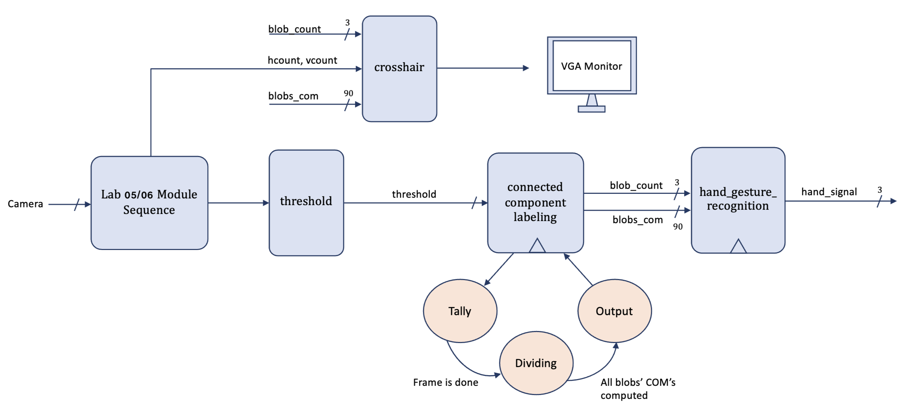
Blob Detection Module Diagram
Notes:
This is the block diagram for this major component. It utilizes modules from the center of mass lab with the major modification of the Connected Component Labeling or CCL module and hand gesture recognition module. After we threshold a pixel, we now enter this state machine, going through states Tally, Dividing, and Output. Tally is the main bulk of the blob detection algorithm, which I’ll explain in a few slides, and its output is the labeling of the largest 5 blobs in the frame. In the Dividing state we calculate the center of mass of all 5 blobs and then we output 90 bits containing the x and y coordinates of these centroids as well as a valid blob bit. This is then fed to the hand gesture module, where we encode the relative positions of x and y blob coordinates to interpret movements like Up, down, scale up, etc.

Slide 15
Threshold Input
0
0
1
1
0
0
1
1
0
Threshold:
Pixel threshold is done one-by-one by color values
0
1
1
1
0
0
1
1
0
0
1
0
1
0
0
0
0
0
0
0
0
0
0
1
1
0
0
1
1
0
0
0
0
0
0
1
1
1
1
0
0
1
1
1
1
Notes:
This is the input we expect. After the thresholding operation, the input is comprised of either a valid or invalid pixel. At the end of a frame, there will be continuous groups of valid pixels (which we refer to as “blobs”) that we want to identify.

Slide 16
Blob Detection Behavior
0
0
1
1
0
0
1
1
0
Blob:
Continuous group of valid pixels or “strongly connected component”
0
1
1
1
0
0
1
1
0
0
1
0
1
0
0
0
0
0
0
0
0
0
0
1
1
0
0
1
1
0
0
0
0
0
0
1
1
1
1
0
0
1
1
1
1
Notes:
In particular, this is the output we expect out of the Tally State

Slide 17
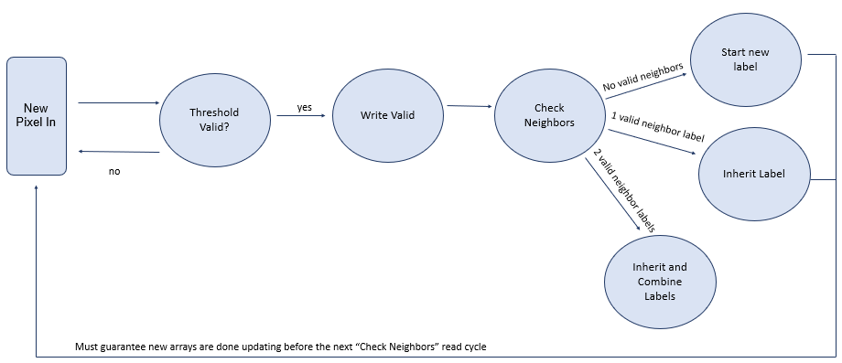
Tally Flow Diagram
Notes:
How does the blob detection algorithm work? A new pixel comes in. We only move on if it’s valid. If so, we enter Write Valid, where we store its x and y coordinates along with a valid bit.
We then proceed to check the valid bits of the neighbors of the current pixel, namely the left pixel and the 3 from the row above. If there are no valid neighbors, congrats, we can start a brand new label.
If there is a valid neighbor, then inherit that neighbor’s label. But if there are 2 valid neighbor labels, then inherit the smallest label and combine or map the labels to each other. This is a method I came up with to avoid rewriting all the labels from a family of labels, which would take extra cycles.
This approach makes it easier to guarantee that the BRAMS we write to are done updating by the time we enter the next “Check Neighbors” read cycle.

Slide 18
Memory Usage
Height = 38,400
Width = 18 bits
Data = {x [7:0], y [8:0], valid bit}
Address | Valid 1
0 | 18’b0
1 | {8’b1, 9’b0, 1’b0}
2 | {8’b10, 9’b0, 1’b0}
… | …
i | {x, y, valid_bit}
… | …
38,399 | 18’b0
Address | Valid 2
38,400 | 18’b0
38,401 | {8’b10100001, 9’b0, 1’b0}
38,402 | {8’b10, 9’b0, 1’b0}
… | …
i | {x, y, valid_bit}
… | …
76,799 | 18’b0
Notes:
For our memory usage, we will first use 2 BRAMS to indicate if a pixel is valid or not, as well as storing the x and y locations to be used for the running x and y sums, needed for the dividing module.
Storing this x and y locations and a valid bit makes the BRAM have a width of 18 bits. Furthermore, we area reading from a camera input size of 320 x 240, so we allocate half in each BRAM to go within the address size limit.
We have user case assumptions like only allowing at most 5 blobs on the input that guarantee we will never have to write all 76800 pixels, but we do it here for robustness, though we can later optimize this.

Slide 19
Mapping each valid pixel to its label for easy access of “read” pixel label
Address | Label 1
0
1 | 1
2 | 1
… | …
i | 0 < i < 11
… | …
38,399 | 2
Address | Label 2
38,400 | 4
38,401 | 4
38,402 | 4
… | …
i | 0 < i < 11
… | …
76,799
Notes:
Similarly, when the pixel inherits a label or creates a new label, that will go in this Label BRAMs. We need them to have an easy way of reading the neighbors valid labels during the check neighbors state. The addresses range again the 76400 pixels.

Slide 20
10 BRAM for 10 blobs (will be finetuned during integration) of height 38,400 because we do not expect blobs of 50% screen size
Array will keep track of which blob labels are linked (thus avoiding rewrites)
Address | Blob 1
0 | 1
… | …
38,399
Address | Blob 2
0 | 54
… | …
38,399
Address | Blob 10
0
… | …
38,399
…
Notes:
Finally, we have 10 BRAMS that hold the pixels of each blob. We will have an array keeping track of which labels have been combined, which helps us not rewrite any labels, thus saving time. This is our second assumption, no blob will be bigger than 50% of screen. With this assumption, we don’t expect needing more than 10 BRAMS. In fact, I’ll talk about fine tuning to our specific use case later, But most likely we can reduce this number of BRAMs.

Slide 21

Sample Walk
New pixel $→$ Valid? $→$ Yes!
Write Valid Pixel
0
0
1
Address | Valid 1
… | …
4 | {8’b1, 9’b1, 1’b1}
… | …
0
1
Check Valid Neighbors
Read from Valid BRAM
Read Neighbor Label
0
0
1
Address | Valid 1
… | …
2 | {8’b10, 9’b0, 1’b1}
… | …
Address | LABEL 1
… | …
2 | 1
… | …
Valid?
0
1
4 cycles, 2 reads
Notes:
Putting it all together, let me walk you through how this process will look like:

Slide 22
Inherit label
Add to Blob 1 BRAM
Address | Label 1
… | …
4 | 1
… | …
Address | BLOB 1
0 | 2’b10
1 | 3’b100
… | …
0
0
1
0
1
New pixel inherited the same label (color)

Slide 23
Optimizations
Locking : Reserve a register for the most recently added pixel in a blob, keep track of its y location. If we exceed y’ > y + 1, then it is impossible to add a new pixel to this blob or to combine with another blob, so “lock” it and start the x and y count and division for this blob.
Fine tuning: With the assumption that we will only have 5 blobs of pink color in the screen, reduce the number of BRAMs or address entries for faster pipelining

Slide 24
Design Evaluation: Video Manipulation
Robustness | Performance | Resource Utilization
Algorithmic efficiency
Accuracy
Memory
Assumption vs.
Real-life Data
How will it response with worst-case inputs
Pipelining for optimization
Are all connected pixels properly match to connected labels?
Is there a consistent blob detection output?
Can we reduce the BRAMS/resources we need?
Can we accurately account for read and write cycle delays?
Notes:
For my design Evaluation, we first have algorithmic robustness. I came up with this algorithm inspired by the Union-Find solution, which upon further thinking is very hard to implement on FPGA as it has complex operations like path augmentation and maintaining a non binary tree, so we cannot precompute space for it.

Slide 25
Project Overview – Video Manipulation
(Commitment) Blob detection algorithm correctly labeling the largest 5 color blobs on the screen and displaying centroids with crosshair pattern, allowing some delay
(Goal) Encoding of hand commands and serialization to FPGA2 for video manipulation
(Stretch) Adding optimizations for smaller latency

Slide 26
Timeline
WEEK 1 | WEEK 2 | WEEK 3 | WEEK 4 | WEEK 5
Connected Component Labeling
Tally Flow
Hand Gesture Encoding
Dividing
Locking Optim.
Crosshair
Bicubic Filter on Python
Upscaling Conv. on FPGA
Pixel Buffering
FSM Pipelining
INTEGRATION / TEST

Slide 27
Q & A

